Slide 1
Sharing and Discussion : How to Publish a Research Paper
27 November 2014
Adiwijaya
Vice Dean for Academic and Student Affairs
School of Computing - Telkom University

Slide 2
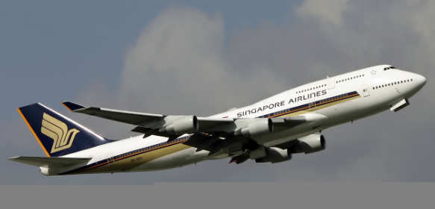
How to Publish a Research Paper

Slide 3
Step by Step :
Tentukan Tujuan
Menyiapkan Tiket dan perlengkapan
Datang ke Terminal Keberangkatan
Check in
Boarding Pass
Masuk ke Pesawat
➔ bismillah

Slide 4
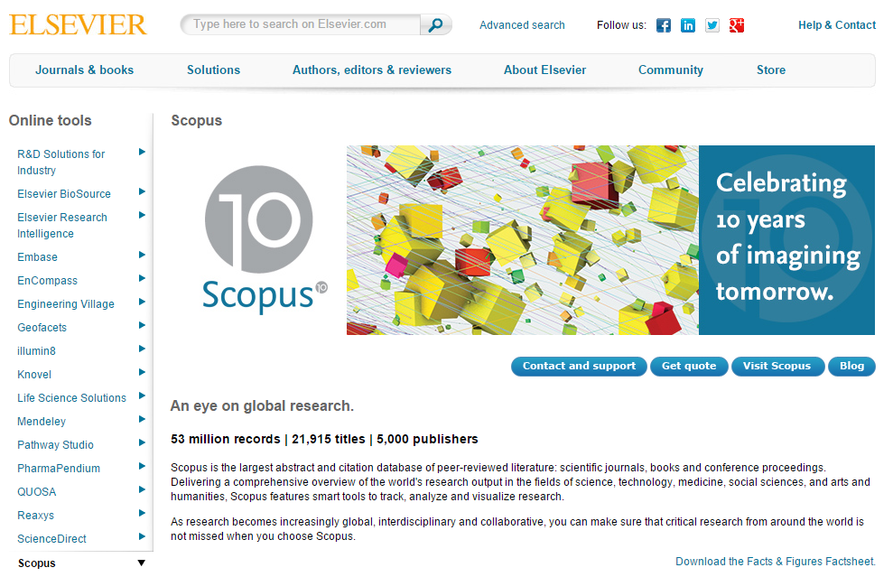

Slide 5
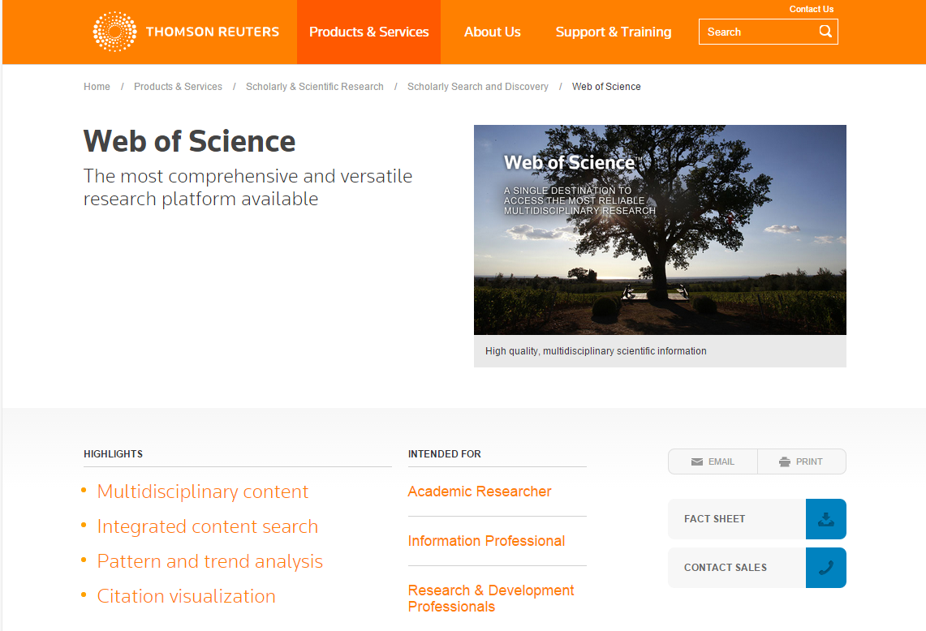

Slide 7
Indexed by?
Scopus,
ISI Web of Science,
ISI Conference Proceedings Citation Index,
EI Engineering Index (Compendex and Inspec databases),
ACM Digital Library,
DBLP,
Google Scholar,
MathSciNet,
Zentralblatt MATH,
Cabells,
EBSCO,
ResearchBib,
ProQuest,
Academia,
ResearchGate

Slide 8
The Problem is ….
➔ Bagaimana menyiapkan tiket dan perlengkapan

Slide 9
What should I do :
Meneliti (research)
0. Berkumpul dalam forum ilmiah (penelitian)
ide penelitian ➔ Pohon Penelitian
Publikasi

Slide 10
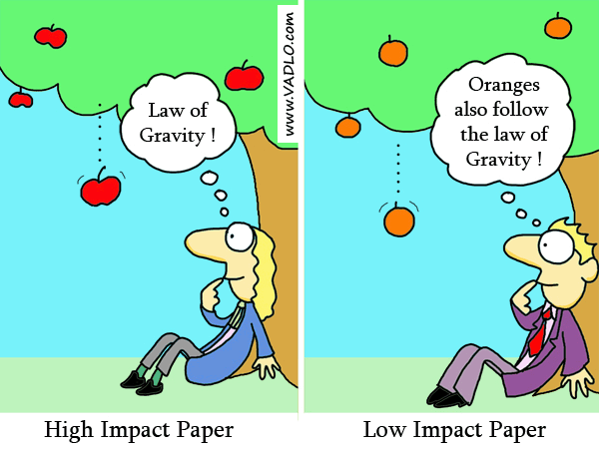
Research Impact

Slide 11
What should I do :

Slide 12
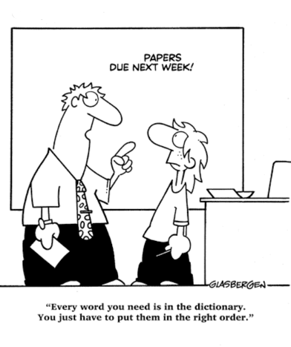
Deadline

Slide 13
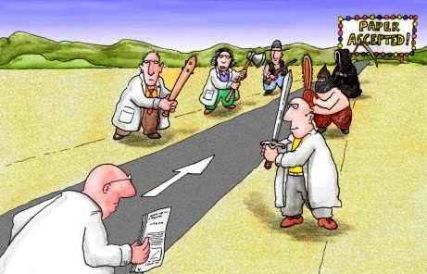
Review Process
➔ Perhatikan Scope of Journal or Conference

Slide 14
Research Paper
Abstract
Introduction (5%-10%)
Related Works (10%-20%)
Problem statement (5%-15%)
Solution Approach and Methodology (40%-50%)
Analysis of Results (15%- 30%)
Conclusions and Future Work (5 – 10%)
Acknowledgements (optional)
References

Slide 15
Enjoy your flight

Slide 16
Beliau menjawab : “Yang paling bermanfaat bagi sesama manusia”.
Saat Rasulullah SAW ditanya: “Siapakah orang terbaik?”
“Allah akan akan meninggikan orang-orang yang beriman diantaramu dan orang-orang yang diberi ilmu pengetahuan beberapa derajat.” (QS. Al Mujadilah [58] : 11)

Slide 17
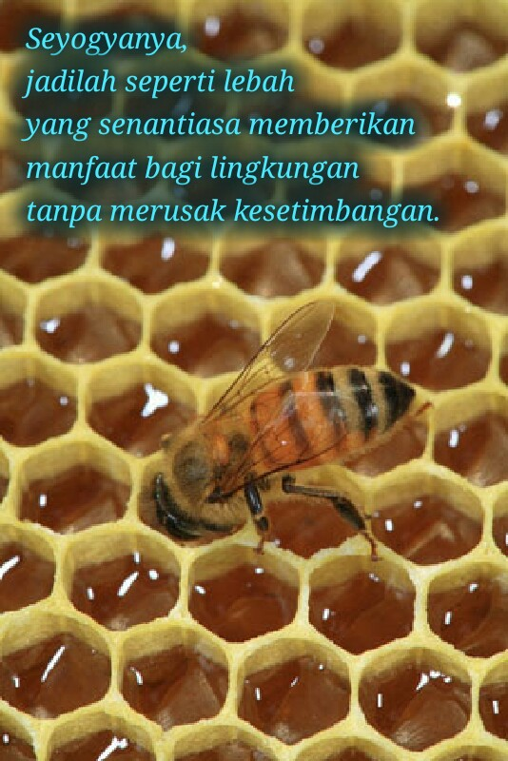
Let's
Be passionate
Do the best
Give more

Slide 18
Let’s publish a paper

