Slide 1
Basic Notions on Graphs

Slide 2
Scope
Sorthest path Problems
Network Flow Problems
Matching Problems
Graph Coloring Problem
Traveling Salesmen Problem

Slide 3
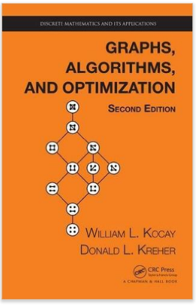
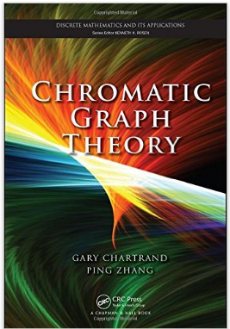
References

Slide 4
The House-and-Utilities Problem

Slide 5
Terminology
A graph G consists of a set V of vertices and
a set E of edges which is a subset of V ×V.
Order: the number of vertices in the graph
Degree: the number of edges attached to a vertex
- in a graph we have maximum degree, minimum degree
if every vertex has the same degree then G is regular.
➔ 2 or more edges joining the same pair of vertices are called multiple edges. An edge joining a vertex to itself is called a loop.

Slide 6
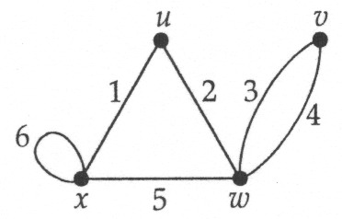
Adjacency and incidence
Two vertices v and w are adjacent vertices if they are joined by an edge e. The vertices v and w are incident with the edge e, and the edge e is incident with the vertices v and w.

Slide 7
Example
G = G(V,E)
V = {A,B,C,D}--The vertex set.
E = {(A,B), (A,C), (B,C), (B,D)}--The edge set.
B
 | A | B | C | D
A |  | 1 | 1
B | 1 |  | 1 | 1
C | 1 | 1
D |  | 1
A
D
C
Notes:
Graphical depiction is easiest for people to grasp
Matrix is easiest for computers and some graph calculations
Vertex and edge sets are a handy way to communicate the graph using text only.

Slide 8
Terminology
Neighbourhood of a vertex is the set of all its adjacent vertices

Slide 9
Terminology
Adjacency matrix A

Slide 10
The Bridges of Konigsberg

Slide 11
The Bridges of Konigsberg
Notes:
Path that includes every edge is referred to as an Eulerian path.

Slide 12
The House-and-Utilities Problem

Slide 13
Planar Graphs
Consider the previous slide. Is it possible to join the three houses to the three utilities in such a way that none of the connections cross?

Slide 14
Planar Graphs
Phrased another way, this question is equivalent to: Given the complete bipartite graph K_{3,3}, can K_{3,3} be drawn in the plane so that no two of its edges cross?
K_{3,3}

Slide 15
Planar Graphs
A graph is called planar if it can be drawn in the plane without any edges crossing.
A crossing of edges is the intersection of the lines or arcs representing them at a point other than their common endpoint.
Such a drawing is called a planar representation of the graph.

Slide 16
Example
A graph may be planar even if it is usually drawn with crossings, since it may be possible to draw it in another way without crossings.

Slide 17
Example
A graph may be planar even if it represents a 3-dimensional object.

Slide 18
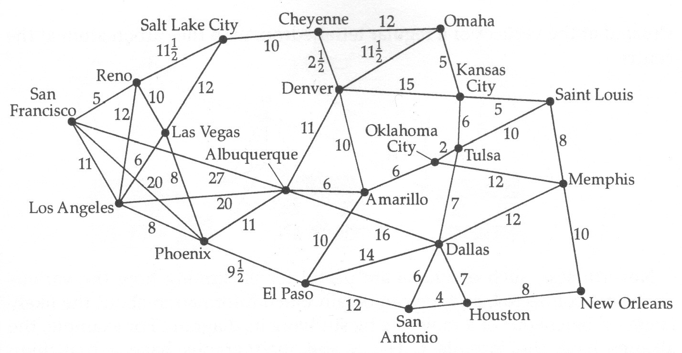
Weighted Graphs
Problem Find the shortest time taken to drive from Los
Angeles to Amarillo, and from San Francisco
to Denver.

Slide 19
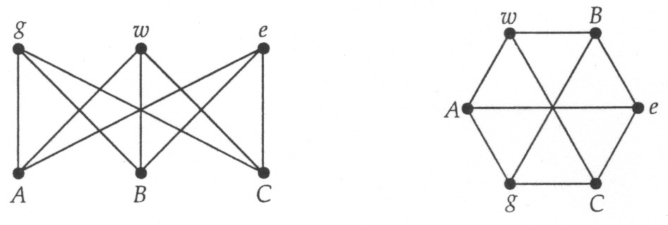
Isomorphism
Two graphs are the same if they have the same set of
vertices and the same set of edges, even if they are drawn
differently.

Slide 20
Isomorphism
Two graphs G and H are the isomorphic if H can be
obtained by relabelling the vertices of G. That is, there is a
1-1 correspondence between the vertices of G and those
of H, such that the number of edges joining each pair of
vertices in G is equal to the number of edges joining the
corresponding pair of vertices in H. Such a
1-1 correspondence is called an isomorphism.

Slide 21
Isomorphism
Checking if two graphs are isomorphic:
number of vertices and edges
look for special features such as short cycles
degrees of vertices, loops, or multiple edges

Slide 22
Isomorphism
Problem Are the following two graphs isomorphic? If
so, find a suitable 1-1 correspondence
between the vertices of the first and those of
the second graph; if not, explain why not.

Slide 23
Counting graphs
How many labelled and unlabelled graphs with the same number of vertices are there?
When counting labelled graphs, we distinguish between any two that are not the same.

Slide 24
Counting graphs
When counting unlabelled graphs, we distinguish between any two that are not isomorphic.
How many unlabelled, connected graphs are there on 1, 2, 3, 4, 5 vertices?

Slide 25
Subgraphs
A subgraph of a graph G is a graph all of whose vertices are vertices of G and all of whose edges are edges of G.

Slide 26
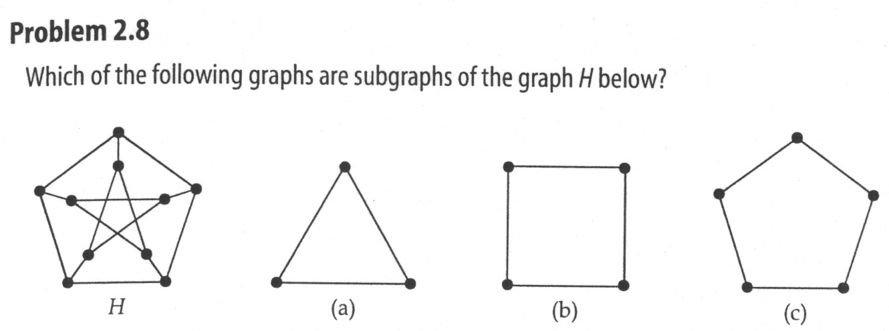
Subgraphs of unlabelled graphs
Problem Which of the following graphs are subgraphs
of the graph H below?

Slide 27
Drawing a graph
Degree Sequence:
4 4 4 4 4
6 6 6 6 4 3 3 0
5 4 3 2 2 1
6 5 5 4 3 3 2 2 2

Slide 28
Terminology
Walk of length t is a non-empty alternating sequence of t edges such that any two consecutive edges share a vertex
Diameter is the longest distance between any two vertices in the graph

Slide 29
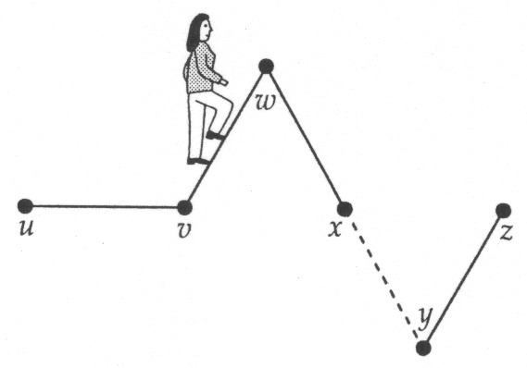
Walks
A walk of length k in a graph is a succession of k edges of the form
uv, vw, wx, …, yz.
This walk is denoted by uvwx…yz, and is referred to as a walk between u and z.

Slide 30
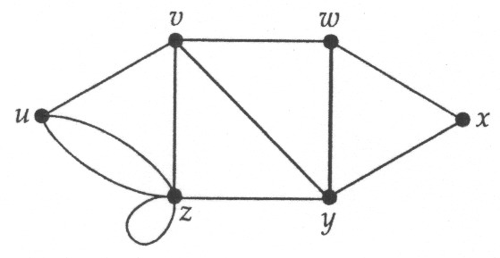
Walks
Note that in a walk, we do not require the vertices and edges to be all distinct. For example, below uvwxywvzzy is a walk of length 9 between u and y; it includes the edge vw twice and the vertices v,w,y and z each twice.

Slide 31
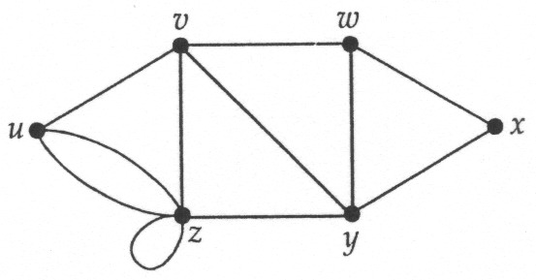
Paths and trails
A trail is a walk in G with the property that no edge is repeated.
A path is a trail in G with the property that no vertex is repeated..
Problem Complete the following statements:
(a) xyzzvy is a…….of length……between….and….;
(b) uvyz is a…….of length……between….and…..

Slide 32
Paths
Problem Write down all the paths between s and y in the following graph:

Slide 33
Closed walks, trails and cycles
A closed walk is a succession of edges of the form
uv,vw,wx,…,yz,zu
That starts and ends at the same vertex.
A closed trail ➔ a circuit
A closed path ➔ a cycle
Eulerian Circuit (degree of every vertex of G is even)
Hamiltonian Cycle (a cycle that contains every vertex of G)

Slide 34
Closed walks, trails and cycles
Problem For this graph, write down
(a) closed walk that is not a closed trail;
(b) closed trail that is not a cycle;
(c) all the cycles of lengths 1,2,3 and 4.

Slide 35
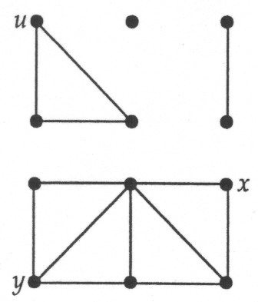
Connected graphs
A graph is connected if there is a path between each pair of vertices, and is disconnected otherwise.

Slide 36
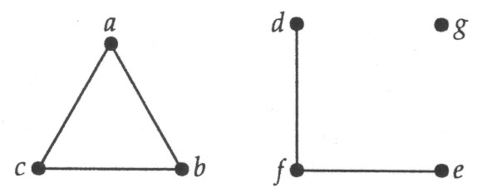
Components
An edge in a connected graph is a bridge if its removal results in a disconnected graph. Every disconnected graph consists of a number of connected subgraphs, called components.

Slide 37
Distances in Graphs
u
The distance between two vertices u and v in a graph d(u,v) is the length of the shortest path between the two vertices.
That is; the fewest number of edges that need to be traversed when going from u to v.
d
e
a
b
c
f
v
The distance from u to v is 4 by the
path ubcfv. There are other paths from
u to v but none shorter than 4.

Slide 38
Distances in Graphs
u
The maximum distance from a vertex u to any other vertex in the graph is called the eccentricity of u ➔e(u).
d
e
a
b
c
f
v
e(u) = 4
e(b) = 3
e(e) = ?
e(a) = ?

Slide 39
Distances in Graphs
u
The maximum distance from a vertex u to any other vertex in the graph is called the eccentricity of u e(u).
The largest eccentricity is called the diameter, the smallest eccentricity is called the radius.
d
e
a
b
c
f
v
e(u) = 4
e(b) = 3
e(e) = 4
e(a) = 4
Note: If the graph is disconnected, the radius and diameter
are infinity

Slide 40
Distances in Graphs
u
The maximum distance from a vertex u to any other vertex in the graph is called the eccentricity of u e(u).
The largest eccentricity is called the diameter, the smallest eccentricity is called the radius.
d
e
a
b
c
f
v
Diameter =
Radius =
4
2
Diameter dan radius ? P_{n} , C_{n}, W_{n}, K_{n}

Slide 41
Tugas Graph Algorithm
Sorthest path Problems
Network Flow Problems
Matching Problems
Graph Coloring Problem
Traveling Salesmen Problem

