Slide 1
Modeling and Optimization 1. Dr. Adiwijaya 2. Aang Nuryaman, M.Si

Slide 2
Nama Dosen : Adiwijaya NO. HP : 0822 176 33 999 Email : adiwijaya@telkomuniversity.ac.id kang.adiwijaya@gmail.com Blog : adiwijaya.staff.telkomuniversity.ac.id

Slide 3
What is a mathematical modelling
A mathematical model is an abstract model that uses mathematical language to describe the behaviour of a system.
Model ➔ Equation or Algorithm

Slide 4
Kenapa Perlu Pemodelan?
Cara mendasar dan quantitatif untuk mengerti suatu sitem atau fenomena
Untuk memberi pengalaman teknik simulasi dari suatu masalah
Membangun komunikasi dengan praktisi, profesional, dan pengambil keputusan

Slide 5
Pemodelan Matematika
Suatu upaya untuk menyatakan suatu masalah nyata melalui bahasa matematika
Contoh : Harga rumah bisa diprediksi berdasarkan
lokasi dan luas bangunan
H = L³ B
dimana H : Harga Rumah,
L : Lokasi Rumah
B : Luas Bangunan

Slide 6
A conectivity
Mathematics
Real World
Mind

Slide 7
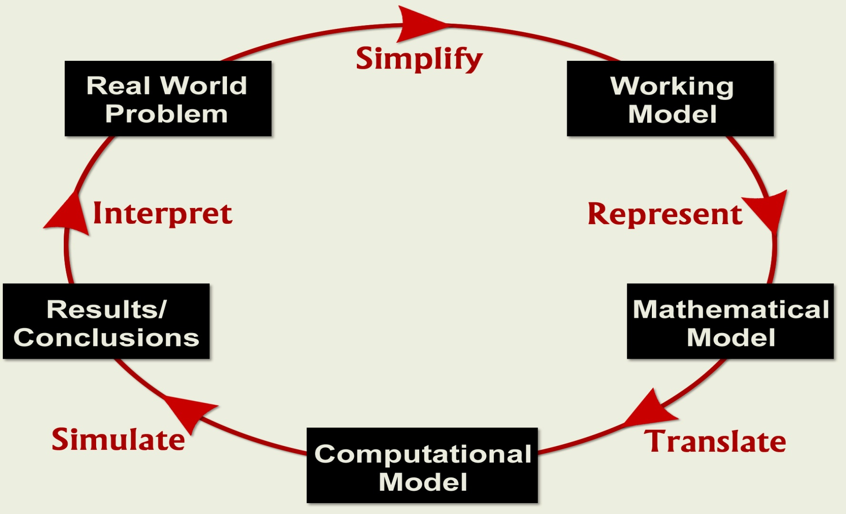
Proses Pemodelan

Slide 8
What is an Optimization
op·ti·mize
tr.v. op·ti·mized, op·ti·miz·ing, op·ti·miz·es
1. To make as perfect or effective as possible.
2. Computers To increase the computing speed and efficiency of (a program), as by rewriting instructions.
3. To make the most of.

Slide 9
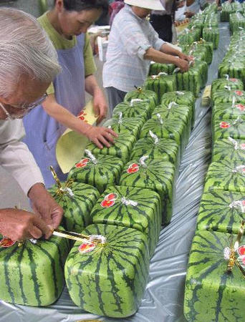

Slide 10
What is an Optimization (2)
an act, process, or methodology of making something (as a design, system, or decision) as fully perfect, functional, or effective as possible;
the mathematical discipline which is concerned with finding the maxima and minima of functions, possibly subject to constraints.

Slide 11
Kontribusi pada masalah dalam dunia nyata
Identifikasi masalah:
Fokus pada masalah yang bisa
dikerjakan.
Melakukan investigasi (Labs/data)
Mempelajari aspek komputasi
Understand current activity and predict future behavior.

Slide 12
Memulai Pemodelan
Identifikasi dan memilih model yang menggambarkan aspek penting dan menentukan faktor yang dapat diabaikan.
Asumsi yang digunakan (simplify).
Menganalisis aturan (hukum) pokok saat pemodelan.
Identifikasi parameter dan inter-relationships.
In general, the success of a mathematical model depends on how easy it is to use and how accurately it predicts.
Notes:
Simplify: Purpose is to eliminate unnecessary information and to simplify that which is retained as much as possible.
Simplifying assumptions: no friction in the system (physics), no immigration or emigration (population), constant growth rate (biology), etc.
Governing principles: laws/relationships from physics, biology, engineering economics, etc.; balance equations.
Key variables and relationships
Variables types include input variables, output variables, and parameters.

Slide 13
Contoh : Industri
Desain digitalisasi pada pesawat, perakitan komputer, optimasi biaya proses manufactur, dll.
Pemodelan dan komputasi meningkatkan kualitas kerja dan mereduksi error dan perbaikan karena kesalahan.
Notes:
!00% digitally designed using 3D computer graphics.
Bottom line: Reduced cost/Reduced time to market.

Slide 14
Contoh: Roadmap otak manusia
Real-time MRI technology
MRI scanners memungkinkan menggunakan MRI dalam pengujian obat dan perencanaan pembedahan otak.
www.itrd.gov/pubs/blue00/hecc.html

Slide 15
Rekonstruksi Citra

Slide 16
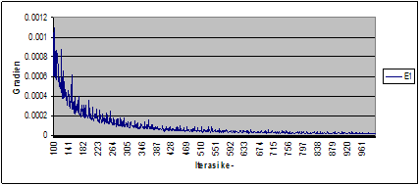
Rekonstruksi Citra (2)

Slide 17
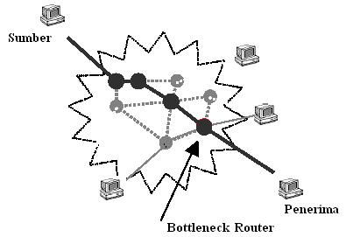
Model aliran TCP

Slide 18
Model aliran TCP (2)
Paket data
penerima
pengirim
router
Paket yang hilang
Round trip time (RTT)
ACK

Slide 19
Model aliran TCP (3)
 | = | Rata-rata ukuran TCP window (paket)
 | = | Rata-rata panjang antrian (paket)
R(t) | = | Round Trip Time (detik)
C | = | Kapasitas link (paket/detik)
N | = | Jumlah aliran TCP
P | = | peluang kehilangan paket

Slide 20
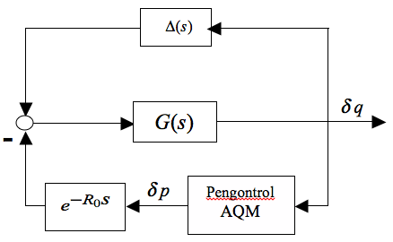
Model aliran TCP (3)

Slide 21
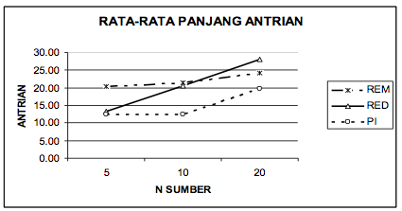
Model aliran TCP (3)

Slide 22
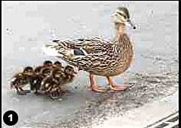
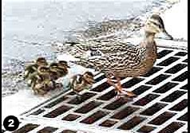
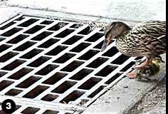
Fokus pada Masalah & Model

Slide 23
How to optimize a system
Model and Starting point
Convergence to global min/max.
Classes of good optimization problems
Find a threshold
Constraint give a trade off

